Slide 1
DRAINAGE

Slide 2
DRAINAGE:-
The term drainage describes the river system of an area.
Drainage Basin:-
The are drained by a single river system is called a drainage basin.
Water Divide.
Any elevated area, such as a mountain or an upland which divides two drainage basins is known as a Water Divide.
River system
A river along with its tributaries may be called a river system.
MB=MEET BHANUSHALI

Slide 3
Drainage Patterns
The streams within a drainage basin form certain patterns, depending on the slope of land, underlying rock structure as well as the climatic conditions of the area . These are dendritic, trellis, rectangular, andradial patterns. The dendritic pattern develops where the river channel follows the slope of the terrain. The stream with its tributaries resembles the branches of a tree, thus the name dendritic. A river joined by its tributaries, at approximately right angles, develops a trellis pattern. A trellis drainage pattern develops where hard and soft rocks exist parallel to each other. A rectangular drainage pattern develops on a strongly jointed rocky terrain. The radial pattern develops when streams flow in different directions from a central peak or dome like structure. A combination of several patterns may be found in the same drainage basin.
MB

Slide 4
MB

Slide 5
SOME FEATURES MADE BY RIVERS
MB

Slide 6
Rivers of India
MB

Slide 7
TYPES OF RIVERS
The drainage systems of India are mainly controlled by the broad relief features of the subcontinents.
Accordingly, the Indian rivers are divided into two parts.
The Himalayan Rivers
The Peninsular rivers
MB
PLEASE CLICK ON ANY ONE TYPE OF RIVER

Slide 8
Himalayan rivers
Rippling along rough surfaces and the beautiful meadows, the numerous rivers that dot Indian mainland are central to our history as well as to Indian mythology. The main rivers of the Himalayas group are the Indus, the Ganga and the Brahmaputra. These rivers are both snow-fed and rain-fed and therefore they are flow through so many year. Himalayan rivers discharge about 70% of their inflow into the sea. This includes about 5% from central Indian rivers. They join the Ganga and drain into the Bay of Bengal
MB

Slide 9
Himalayan Rivers
Major Himalayan Rivers are
The Indus.
The Ganga.
The Brahmaputra.
The Himalayan rivers are long, and are joined by many large and important tributaries. A river along with its tributaries may be called a river system
MB

Slide 10
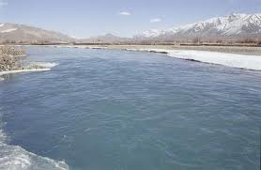
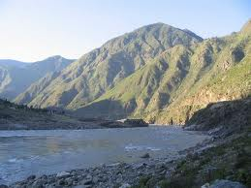
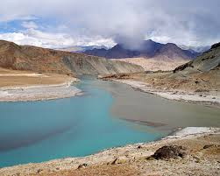
THE INDUS RIVER
MB

Slide 11
THE RIVER INDUS
i. River Indus rises in Tibet, near Lake Mansarowar.
ii. It flows west and enters India in the Ladakh district of Jammu and Kashmir through a picturesque gorge.
iii. Several tributaries like the Zaskar, the Shyok, and the Huzana join it here.
iv. It flows through Baltistan-the Gilgit and emerges from the mountain of Attok.
v. Famous five rivers of Punjab-the Satluj, the Beas, the Ravi, the Chenab and the Jhelum-meet the Indus a little above Mithankot in Pakistan.
.
MB

Slide 12
THE RIVER INDUS
vi. After this the Indus River flows southwards and ultimately meets the Arabian Sea.
Vii. The total length of the river is about 2900 km. This length ranks it one amongst the longest river of the world.
viii. Nearly 33.3% the Indus basin is located in India-in the states of Jammu and Kashmir, Himachal Pradesh and the Punjab and the 67% is in Pakistan.
Ix. According to the provisions of the Indus Water Treaty (1960) India can only use 20% of the total water carried by this river system.
x. This water is used for irrigation in the Punjab, Haryana and the western parts of Rajasthan
MB

Slide 13
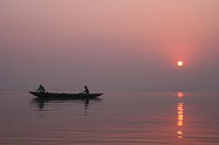
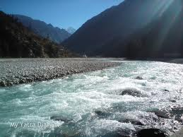
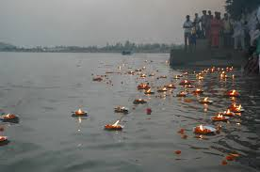
THE GANGA RIVER
MB

Slide 14
THE RIVER GANGA
The Ganges has many names associated with its many roles in Sanskrit mythology. Bhagiratha himself is the source of the name Bhagirathi (of Bhagiratha), which is its initial stream, but is also another name for the Hooghly. At one point, Bhagiratha went too close to the sage Jahnu's meditation site, and the disturbed hermit immediately gulped up all the waters. Eventually, after more persuasion from Bhagiratha, the sage yielded the waters, but Ganges retained the name "Jahnavi“. Water from the Ganga has the recursive property that any water mixed with even the minutest quantity of Ganga water becomes Ganga water, and inherits its healing and other holy properties. Also, despite its many impurities, Ganga water does not rot or stink if stored for several days.
MB

Slide 15
Numerous Tributaries:
i. From the north, the Ganga is joined by numerous tributaries like-the Yamuna, the Gomti, the Ghaghara, the Gandak and the Kosi.
ii. The river Yamuna rises from the Yamunotri Glacier in the Himalayas.
a. It flows parallel to the Ganga.
b. It is the right bank tributaries of the Ganga and meets the Ganga at Allahabad.
iii. The Ghaghara, the Gandak and the Kosi rise in the Nepal Himalayas.
These rivers flood parts of the northern plain every year, causing widespread havoc but enriching the soil for the extensive agricultural lands of the north plains.
iv. The main tributaries coming from the peninsular uplands, are the Chambal, the Betwa, the Son and the Damodar.
a. They rise from semiarid areas.
MB

Slide 16
Numerous Tributaries:
b. They have shorter courses and do not carry much water in them.
v. Ganga is enriched with the waters from its right and left bank tributaries.
vi. It flows eastwards till Farakka in West Bengal. This is the northernmost point of the Ganga delta.
The river bifurcates here.
vii. The Bhagirathi-Hooghly (distributary) flows southward through the deltaic plains to the Bay of Bangal.
viii. The mainstreams flow southward into the Bangladesh and is joined by the Brahmaputra. It is known as the Jamuna here, further downstream. It is known as the Meghna.
ix. This mighty river, with waters from Ganga, and the Brahmaputra flows into the Bay of Bangal and forms the Sunderban delta. It is the most classic and the largest delta of the world.
MB

Slide 17
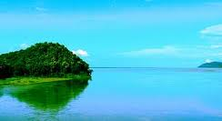
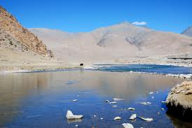
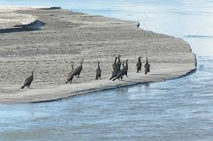
THE BRAHMAPUTRA RIVER
MB

Slide 18
THE RIVER BRAHMAPUTRA
i. Brahmaputra rises in Tibet, east of Mansarowar Lake very close to the sources of the Indus and the Satluj.
ii. In Tibet, it is known by the name, Tsang Po.
iii. It is slightly longer than the Indus, and most of its course lies in Tibet.
iv. It flows eastwards parallel to the Himalayas to its south.
v. When it reaches mountain peak of Namcha Barwa (7757 m), it takes a 'U' twin and makes a 5500 m deep gorge.
vi. Then it enters India in Arunachal Pradesh through a gorge. Here it is called the Dihang and it is joined by the Dibang, the Lohit, the Kenula and numerous other tributaries to form the Brahmaputra in Assam.
MB

Slide 19
THE RIVER BRAHMAPUTRA
vii. In Tibet Tsang Po river carries a smaller volume of water and less silt as it is a comparatively dry and hard rocked area.
viii. In India it passes through a region, which receives a huge amount of rainfall. The result is that the river carries a large volume of water and considerable amount of silt.
ix. The Brahmaputra has a braided channel in its entire length in Assam, with numerous riverine islands.
x. Every year during the rainy season, Brahmaputra River floods its banks and causes widespread devastation in Assam and Bangladesh.
xi. The river also shifts its channels during rainy season every year.
MB

Slide 20
PENINSULAR RIVER
The main water divide in Peninsular India is formed by the Western Ghats, which runs from north to south close to the western coast .Most of the major rivers of the Peninsula such as the Mahanadi, the Godavari, the Krishna and the Kaveri flow eastwards and drain into the Bay of Bengal. These rivers make deltas at their mouths. There are numerous small streams flowing west of the Western Ghats .The Narmada and the Tapi are the only long rivers, which flow west and make esturies .The drainage basins of the peninsular rivers are comparitevely small in size.
MB

Slide 21
PENINSULAR RIVERS
THE MAJOR PENINSULAR RIVERS ARE:-
THE NARMADA.
THE TAPI.
THE GODAVARI.
THE MAHANADI.
THE KRISHNA.
THE KAVERI.
MB

Slide 22
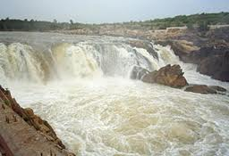
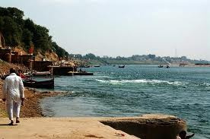
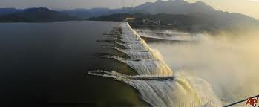
THE NARMADA RIVER
MB

Slide 23
THE RIVER NARMADA
The Narmada rises in the Amarkantak hills in Madhya Pradesh. It flows towards the west in a rift valley formed due to faulting. On its way to the sea, the Narmada creates many picturesque locations. The ‘Marble rocks’, near Jabalpur where the Narmada flows through a deep gorge, and the ‘Dhuadhar falls’ where the river plunges over steep rocks ,are some of the notable ones. All the tributaries of the Narmada are very short and most of these join the main stream at right angles. The Narmada basin covers parts of Madhya Pradesh and Gujarat.
MB

Slide 24
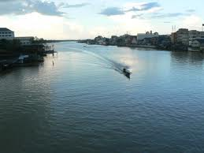
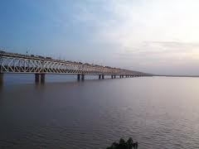
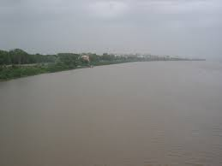
THE RIVER TAPI
MB

Slide 25
THE RIVER TAPI
The Tapi rises in the Satpura ranges, in the Betul district of Madhya Pradesh. It also flows in a rift valley parallel to the Narmada but it is much shorter in length. Its basin covers parts of Madhya Pradesh, Gujarat and Maharashtra.
The coastal plains between western ghats and the Arabian sea are very narrow. Hence , the coastal rivers are short. The main west flowing rivers are Sabarmati, Mahi ,Bharathpuzha and Periyar. Find out the states in which these rivers drain the water
MB

Slide 26
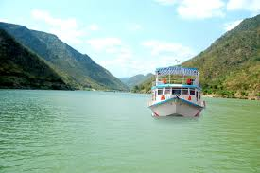
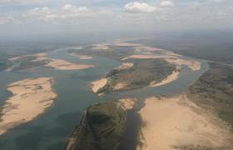
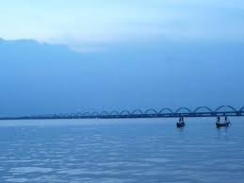
THE RIVER GODAVARI
MB

Slide 27
THE RIVER GODAVARI
The Godavari is the largest Peninsular river .It rises from the slopes of the Western Ghats in the Nasik district of Maharashtra. Its length is about 1500 km .It drains into the Bay of Bengal. Its drainage basin is also the largest among the peninsular rivers. The basin covers parts of Maharashtra (about 50per cent of the basin area lies in Maharashtra),Madhya Pradesh, Orissa and Andhra Pradesh. The Godavari is joined by a number of tributaries such as the Purna, the Wardha,the Pranhita, the Manjra, the Wainganga and the Penganga.The last three tributaries are very large. Because of its length and the area it covers, it is also known as the‘Dakshin Ganga’.
MB

Slide 28
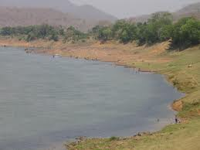
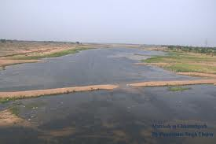
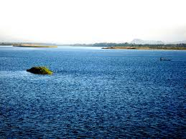
THE MAHANADI RIVER
MB

Slide 29
THE MAHANADI RIVER
The Mahanadi rises in the highlands of Chhattisgarh. It flows through Orissa to reach the Bay of Bengal. The length of the river is about 860 km. Its drainage basin is shared by Maharashtra, Chhattisgarh, Jharkhand, and Orissa.
MB

Slide 30
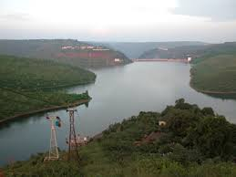
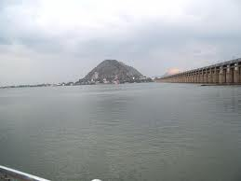
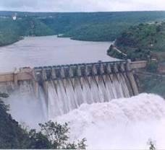
THE KRISHNA RIVER
MB

Slide 31
THE KRISHNA RIVER
Rising from a spring near Mahabaleshwar, the Krishna flows for about 1400 km and reaches the Bay of Bengal. The Tungabhadra, the Koyana, the Ghatprabha, the Musi and the Bhima are some of its tributaries. Its drainage basin is shared by Maharashtra, Karnataka and Andhra Pradesh.
MB

Slide 32
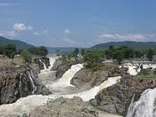
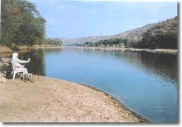
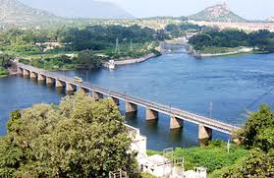
THE KAVERI RIVER
MB

Slide 33
THE KAVERI RIVER
The Kaveri rises in the Brahmagri range of the Western Ghats and it reaches the Bay of Bengal in south of Cuddalore, in Tamil Nadu. Total length of the river is about 760 km. Its main tributaries are Amravati, Bhavani, Hemavati and Kabini. Its basin drains parts of Karnataka, Kerala and Tamil Nadu.
MB

